Slide 1

More applications of FF (Learning different types of Digital Counters)
CS206
By: Dr. Anirban Sengupta

Slide 2
Synchronous and Asynchronous Counters
S.NO | SYNCHRONOUS COUNTER | ASYNCHRONOUS COUNTER
1. | In synchronous counter, all flip flops are triggered with same clock simultaneously. | In asynchronous counter, different flip flops are triggered with different clock, not simultaneously.
2. | Synchronous Counter is faster than asynchronous counter in operation. | Asynchronous Counter is slower than synchronous counter in operation.
3. | Synchronous Counter does not produce any decoding errors. | Asynchronous Counter produces decoding error.
4. | Synchronous Counter is also called Parallel Counter. | Asynchronous Counter is also called Serial Counter.
5. | Synchronous Counter designing as well implementation are complex due to increasing the number of states. | Asynchronous Counter designing as well as implementation is very easy.
6. | Synchronous Counter will operate in any desired count sequence. | Asynchronous Counter will operate only in fixed count sequence (UP/DOWN).
7. | Synchronous Counter examples are: Ring counter, Johnson counter. | Asynchronous Counter examples are: Ripple UP counter, Ripple DOWN counter.

Slide 3
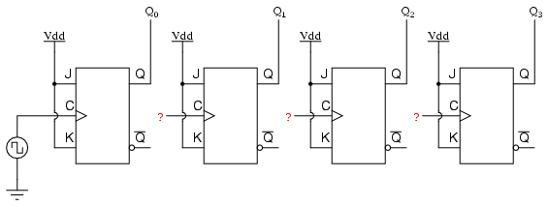
Asynchronous Up-Counter

Slide 4
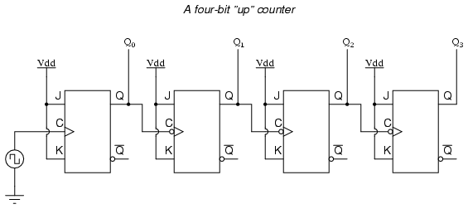
Asynchronous Up-Counter

Slide 5
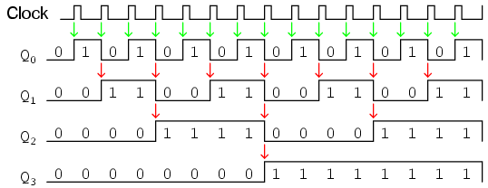
Asynchronous Up-Counter

Slide 6
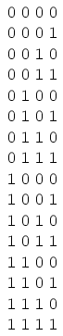
Asynchronous Up-Counter

Slide 7
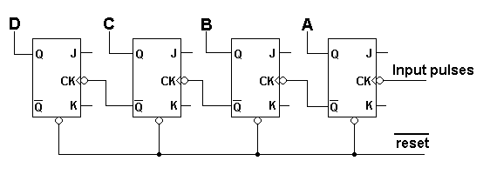
Asynchronous Down-Counter

Slide 8
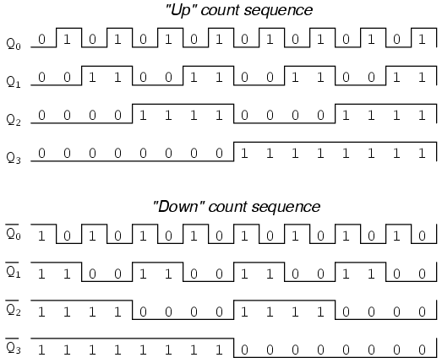
Asynchronous Down-Counter

Slide 9
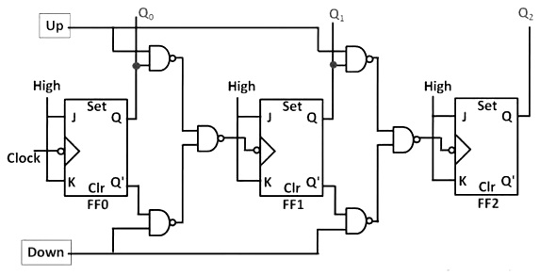
Asynchronous Up/Down-Counter

Slide 10
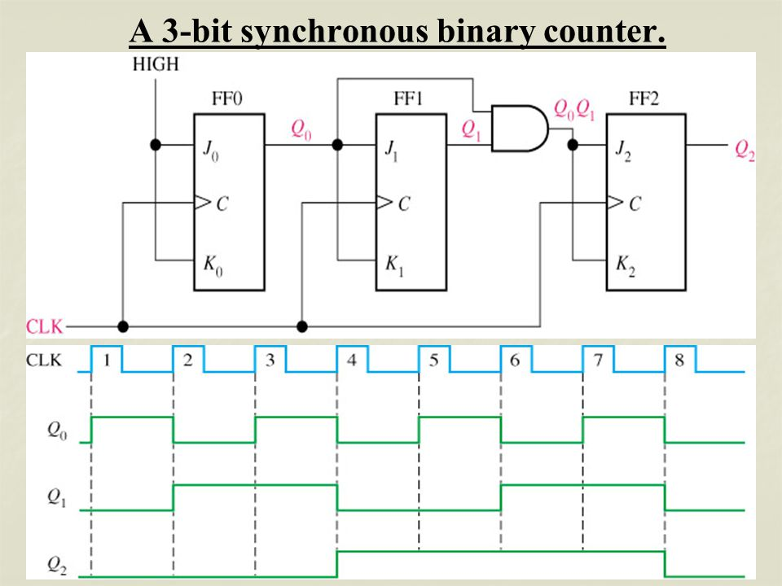
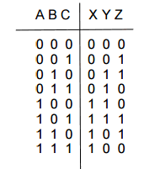
Synchronous Up-Counter
Q2 Q1 Q0

Slide 11
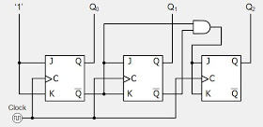
Synchronous Down-Counter

Slide 12
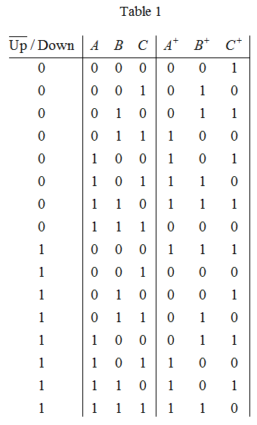
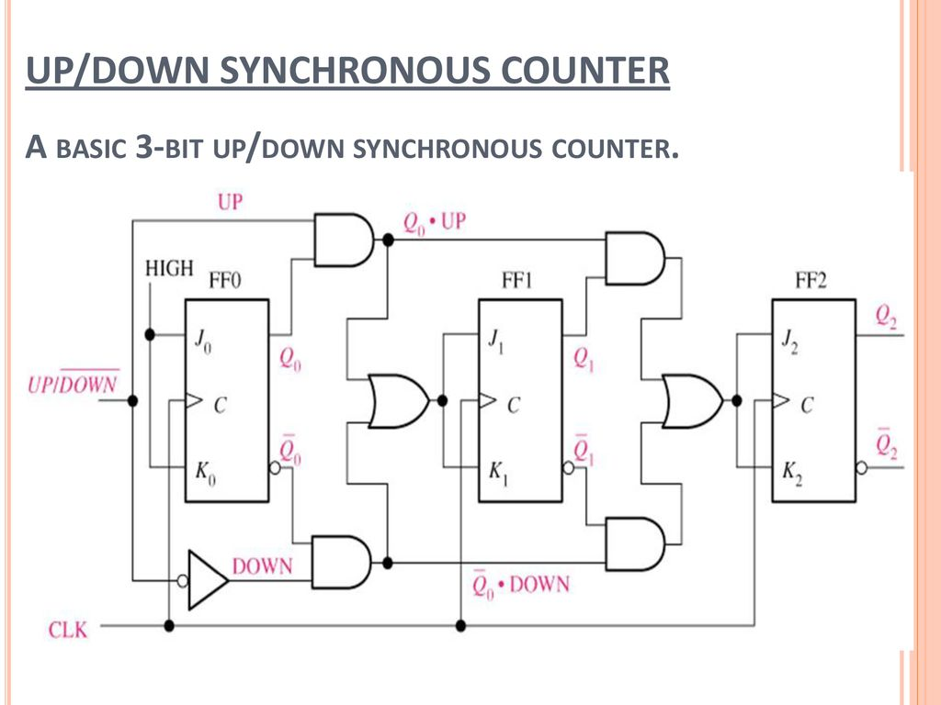
Synchronous Up/Down-Counter

